Slide 1

MESA – upgrade
Back to the desktop

Slide 2
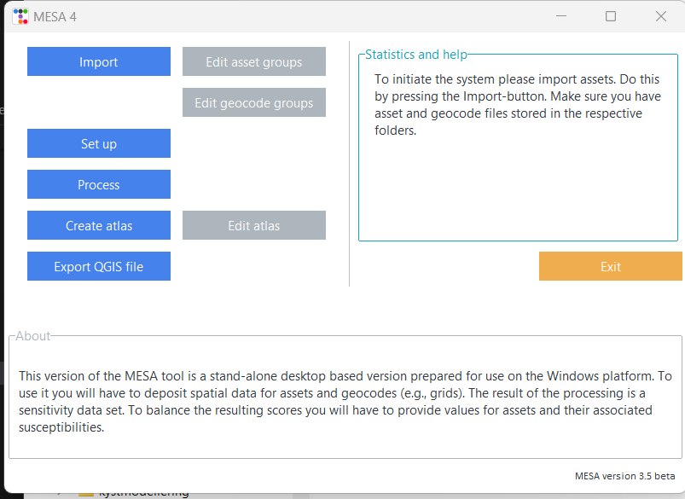
MESA upgrade
Fully reworked
Desktop-based
Free and open – no license requirements
Windows, Linux and Mac

Slide 3
Workflow
Import data
Renaming of asset names
Set up processing
Asset values
Process data
Susceptibilities
Renaming of geocode names
Template which shows data
QGIS
Files ready to be used with QGIS

Slide 5
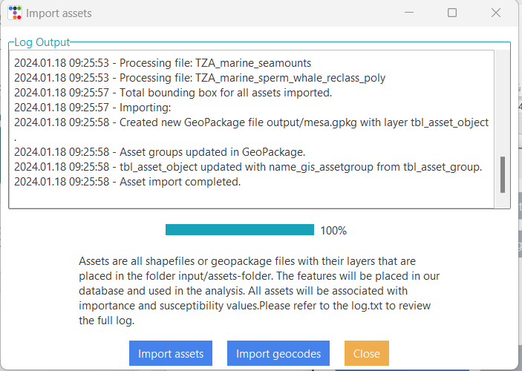

Slide 6
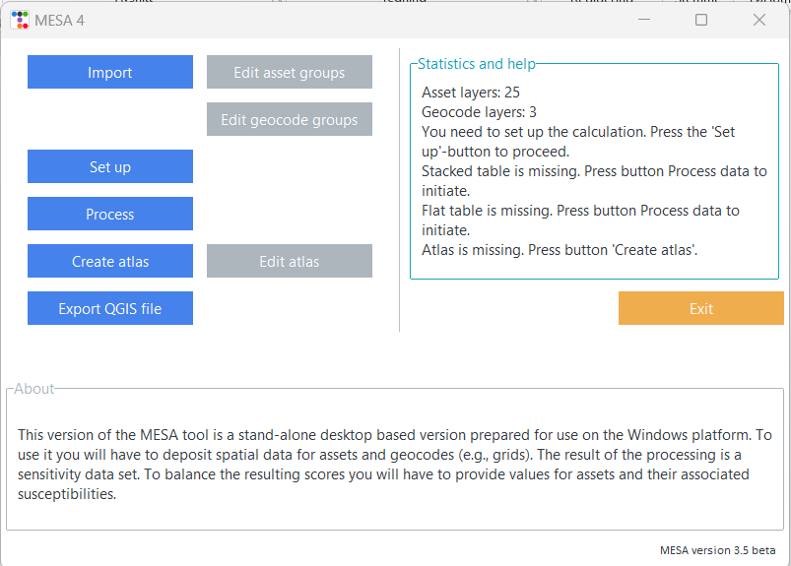


Slide 7
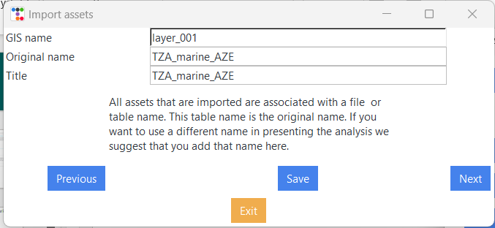
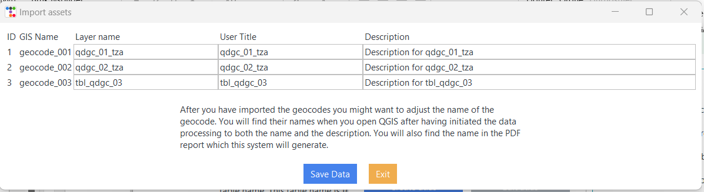

Slide 8
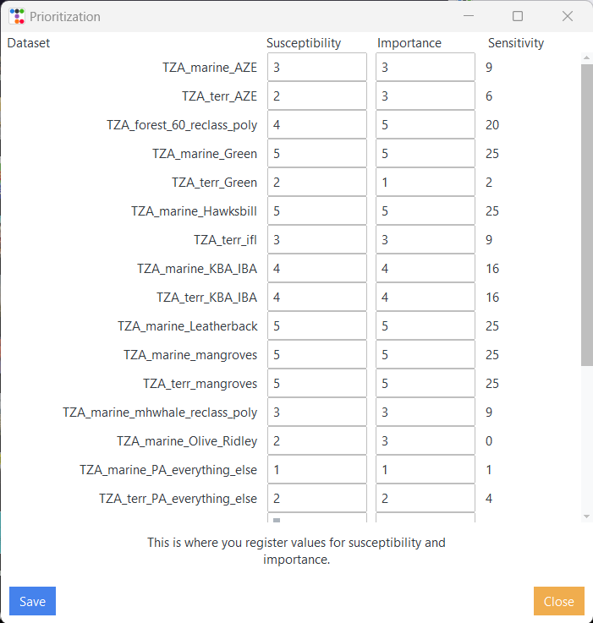

Slide 9
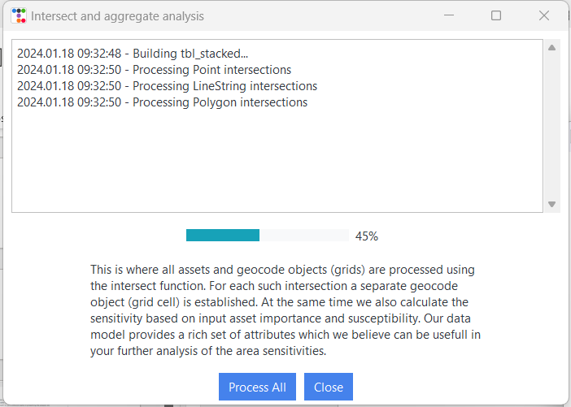

Slide 10
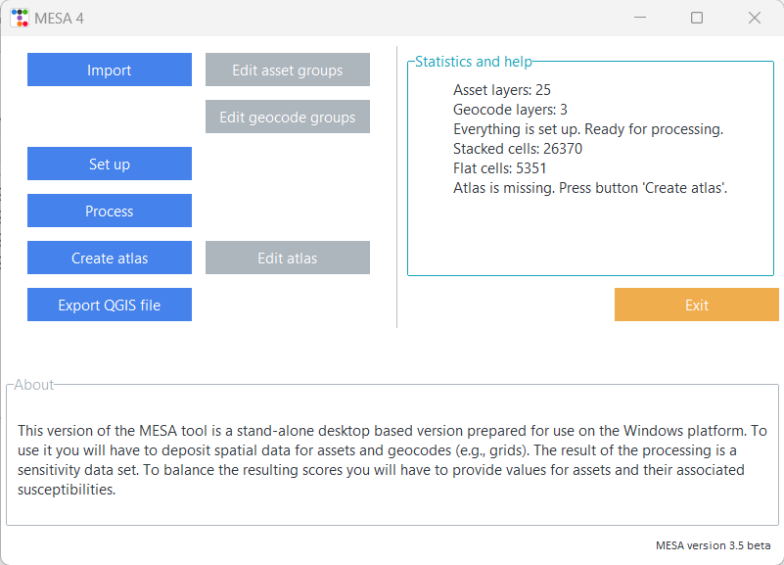


Slide 11
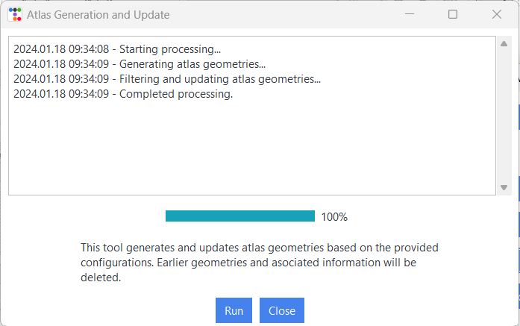

Slide 12
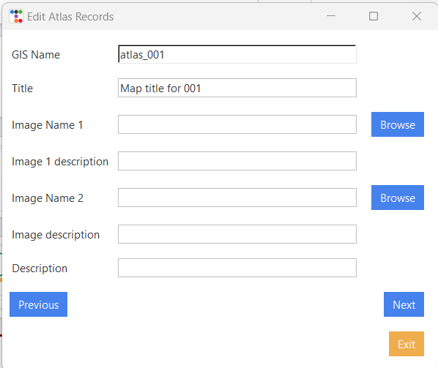

Slide 13
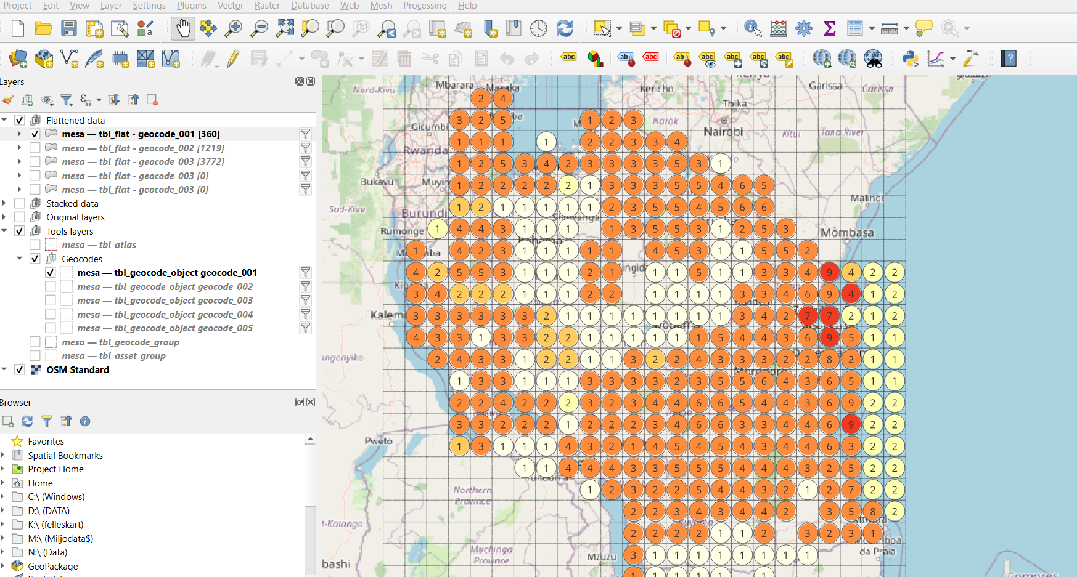

Slide 14
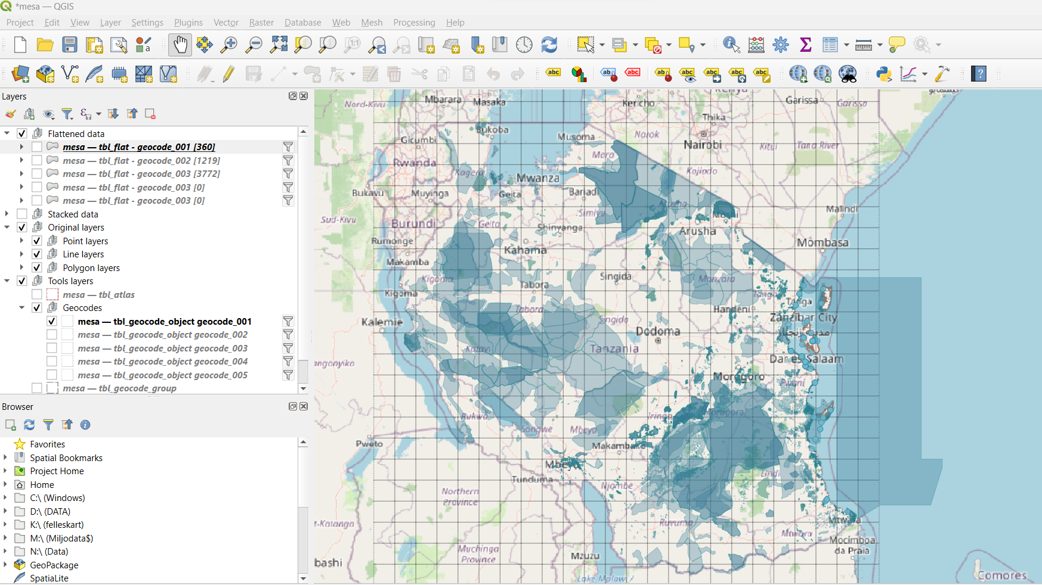

Slide 15
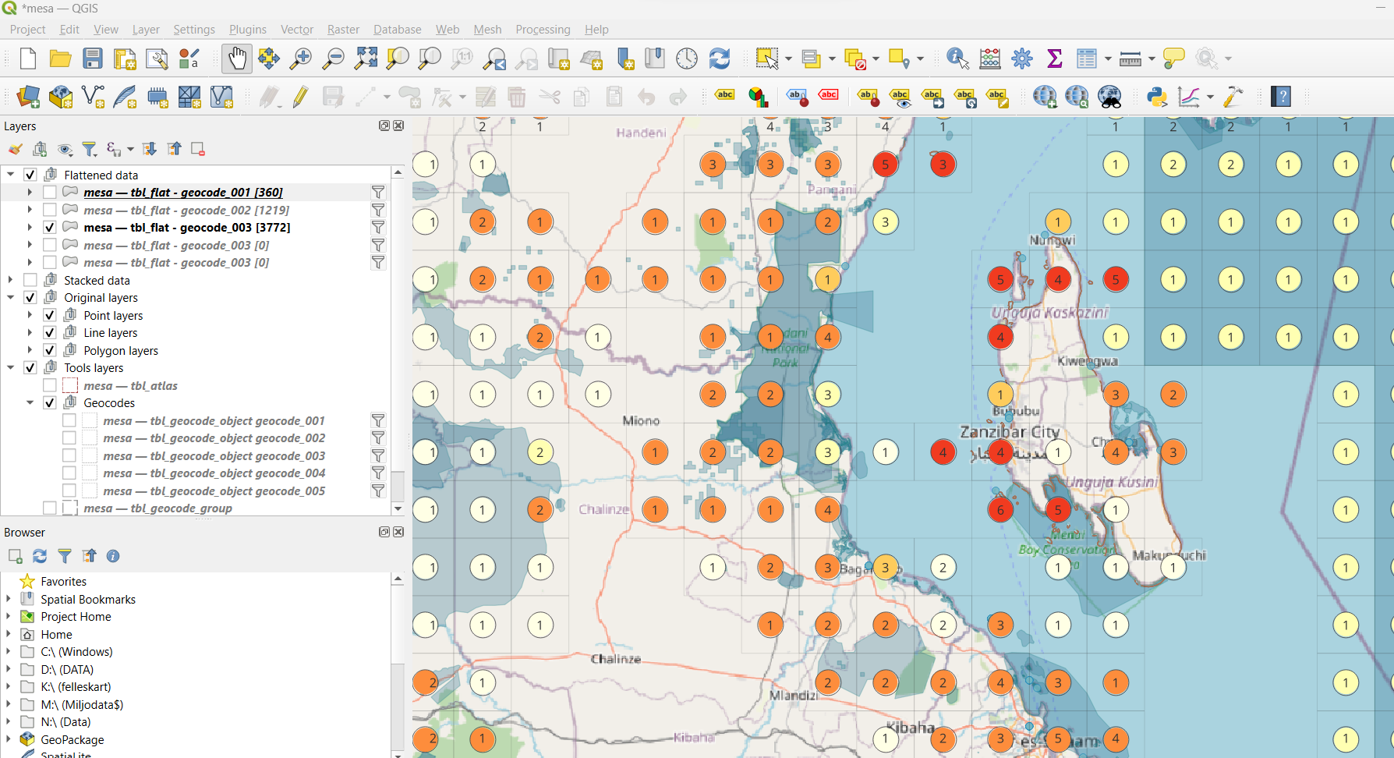

Slide 16
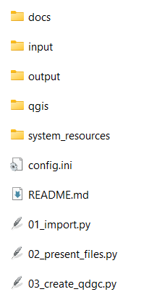
Structure
Much like the online version
Data model simpler since this does not represent several users
No GDPR issues since it is local

Slide 17
Then what?
Short term:
Revise according to feedback
Create training materials and documentation
Announce new version
Training for users
Distribute code/background
Long term:
Professional development
In-house WCMC?
Subcontracting?
Further development
QGIS plugin?
Emergency response support?
Land use planning support?

Slide 18
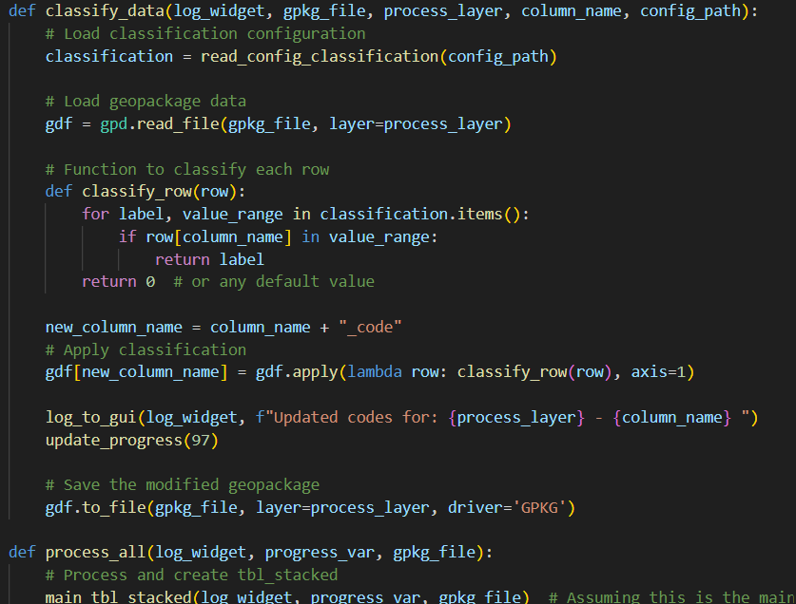
For the nerds…
Programming language is Python 3.11
2000 lines of code
Many libraries (predefined resources)
Can be used on Windows, Linux and MacOS
Made with a little help from ChatGPT

Slide 19
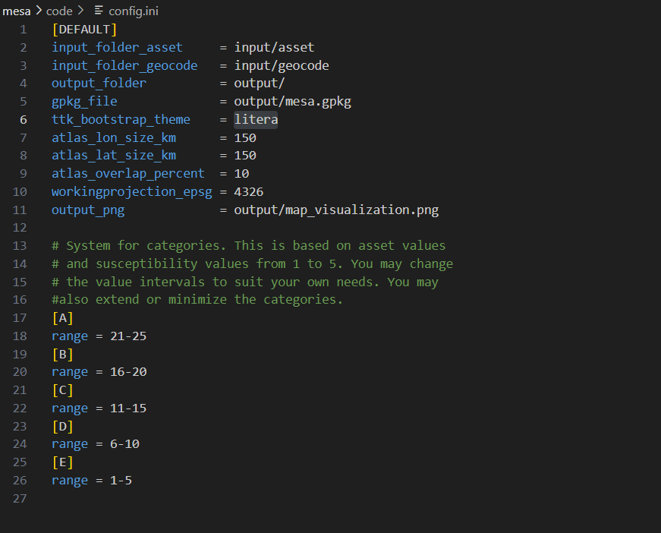

Slide 20


